Slide 1
Interest Link
Capstone Strategies

Slide 2
Table of contents
01
02
03
04
06
05
Introduction
Application Technology
System Architecture & Processes
Future AI Integration
AWS Scalability & Automation
Market Strategy & Revenue Roadmap

Slide 3


Introduction
Connecting communities through shared interests
Unified platform for users, businesses, & community groups
Notes:
Problem Statement (0-10 seconds) Brief mention of how difficult it is to find people with shared interests
Highlight isolation/disconnect people feel in today's digital world
Solution Introduction (10-20 seconds) Introduce InterestLink as the answer
Our digital Route 66 - a pathway designed for discovery and connection, built to connect you to your travel companions.
One clear sentence about what the platform does
Mention key differentiator from other social platforms
Core Features (20-30 seconds) Interest-based matching
Community groups and forums
Events discovery and participation
(Keep to 3 max for this timeframe)
Value Proposition (30-40 seconds) How InterestLink transforms the way people connect
Clear call to action
Partnership/monetization model brief mention

Slide 4
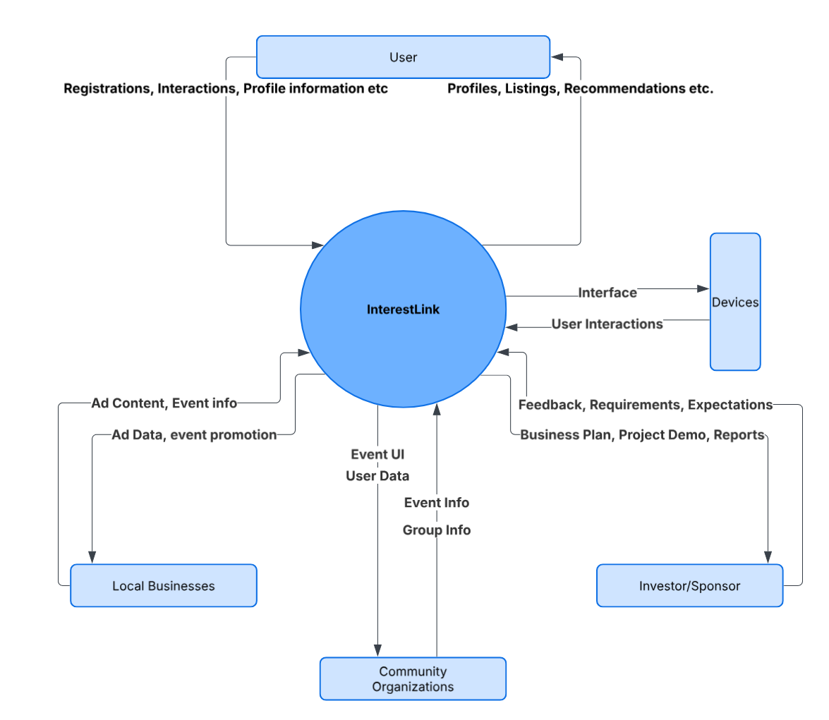
System Architecture & Processes
InterestLink Overview: Connects users with local events and businesses based on shared interests.
Main Players: Involves users, businesses, community organizations, and investors.
How It Works: Users are matched with events and businesses, while businesses and groups provide targeted content.
Wrap-Up: InterestLink creates meaningful connections for all stakeholders.
Notes:
Rays Slide

Slide 5
Application Technology
Tech Stack Overview
User Interactions
Flask (Backend), Express (Frontend), MySQL on AWS RDS (Database), and session-based authentication for managing logins
Data retrieval and updates for features like account creation, login, and bio updates
Scalability & Performance
Event & Group Handling
Technologies for creating and managing events and groups within the platform.
The architecture supports scalability and efficient handling of user interactions and data
Notes:
Fathima’s Slide
"InterestLink is powered by a reliable and scalable tech stack. On the backend, we use Flask, which handles all the server-side logic and routes. For the frontend, we use Express, which renders the user interface and manages the presentation layer. Data is stored in MySQL, hosted on AWS RDS, providing secure and scalable database management.
User interactions, like signing up, logging in, or updating profiles, are processed smoothly thanks to session-based authentication. The platform also supports creating and managing events and groups, making it easy for users to stay connected and engaged. Finally, the system architecture is designed to ensure high performance and scalability, so it can grow with our user base while maintaining responsiveness and reliability."

Slide 6
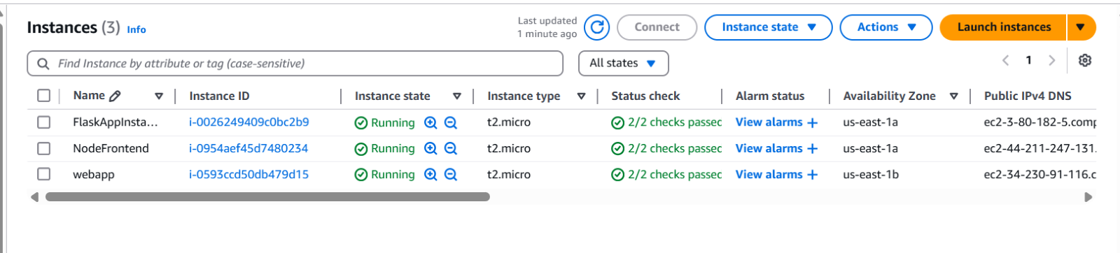
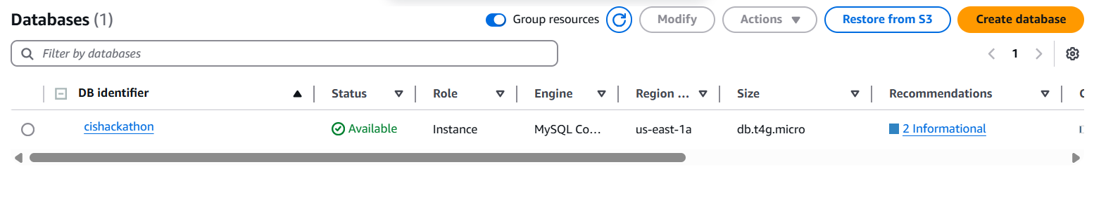
AWS Scalability & Automation
Frontend
Backend
Express.js on an EC2 in a public subnet
Python Flask on a private EC2
Database
MySQL on AWS RDS in a private subnet
As traffic grows, we can scale EC2 w/ load balancers and auto-scaling.
The RDS supports read replicas & multi-AZ for better performance and uptime.
Automation
The RDS would run daily backups and weekly manual snapshots.
Utilized express-session to manage the user sessions.
Event actions like RSVP & discovery is handled by the backend and stored in the RDS.
Recommendations?
As we grow and work with more businesses, CloudFormation can help partners deploy infrastructure that reflect ours-faster & reliable.
Notes:
Jeremy’s Slide InterestLink is built on AWS with scalability and automation in mind. We used a three-tier architecture setup:
For the Frontend, we used Express.js on an EC2 in a public subnet
For the Backend, we used Python Flask on a private EC2
For the Database:, we used MySQL on RDS in a private subnet
As traffic grows, we can scale the EC2 with load balancers and auto-scaling. RDS supports read replicas and multi-AZ for better performance and uptime.
For automation:
RDS runs daily backups and weekly manual snapshots
We use express-session to manage the user sessions
Event actions like RSVP and discovery are handled by the backend and is stored in the RDS
As we grow and work with more businesses, CloudFormation can help partners deploy infrastructure that mirrors ours—faster and more reliably.

Slide 7
Market Strategy & Revenue Roadmap
250,000 users
14% conversion rate
$2.1M in annual revenue
65%
66%
Bumble Friends - $72 per paid user annually
Eventbrite - $3.60 per registered user
Meetup achieves 9% conversion to paid subscription
Gen Z
Access Platform Daily
1.5 million concurrent users
Met their friends online
Notes:
Brittany’s Slide

Slide 8
Future AI Integration
AI-Powered Matching: Use AI to match users based on interests and location.
Improved User Experience: Personalize user interactions through AI recommendations.
Scalability with AI: AI to optimize the platform’s scalability for growing user demands.
Data-Driven Insights: Leverage AI to provide valuable insights and analytics for user engagement.
Notes:
Fathima’s Slide
"Looking to the future, AI-powered matching will play a crucial role in connecting users with events, groups, and businesses based on their unique interests and locations. This will enhance the overall user experience, providing tailored recommendations that keep users engaged and satisfied with the platform.
As InterestLink grows, AI will help us optimize scalability, ensuring the platform can handle increasing demand without compromising performance. Through continuous analysis of user behavior and system usage, AI will proactively adjust resources to meet the needs of the user base.
Another benefit of AI is its ability to provide data-driven insights. With AI, we’ll gather valuable analytics on user engagement, which can be used by businesses and community groups to refine their strategies and improve targeted content, driving deeper user interactions and satisfaction."

Slide 9
DEMO

Slide 10
Q/A
Thanks!

